Slide 1
Wildlife In Crisis
Made By:
Navya Gupta (10-B)
Akshans Gupta (9-C)
School:
Montfort School, Delhi

Slide 2
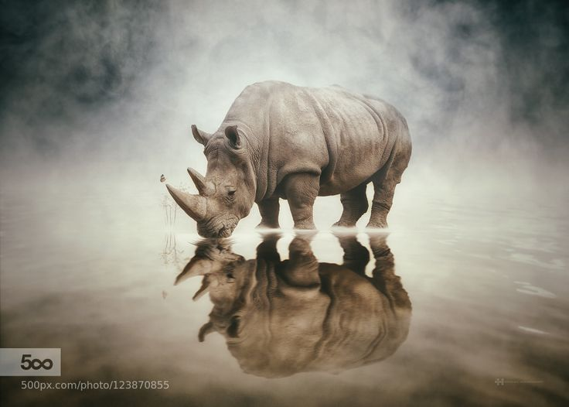
Only if we
UNDERSTAND
can we care
Only if we
CARE
we will help
Only if we
HELP
can they be saved.
—Jane Goodall

Slide 3
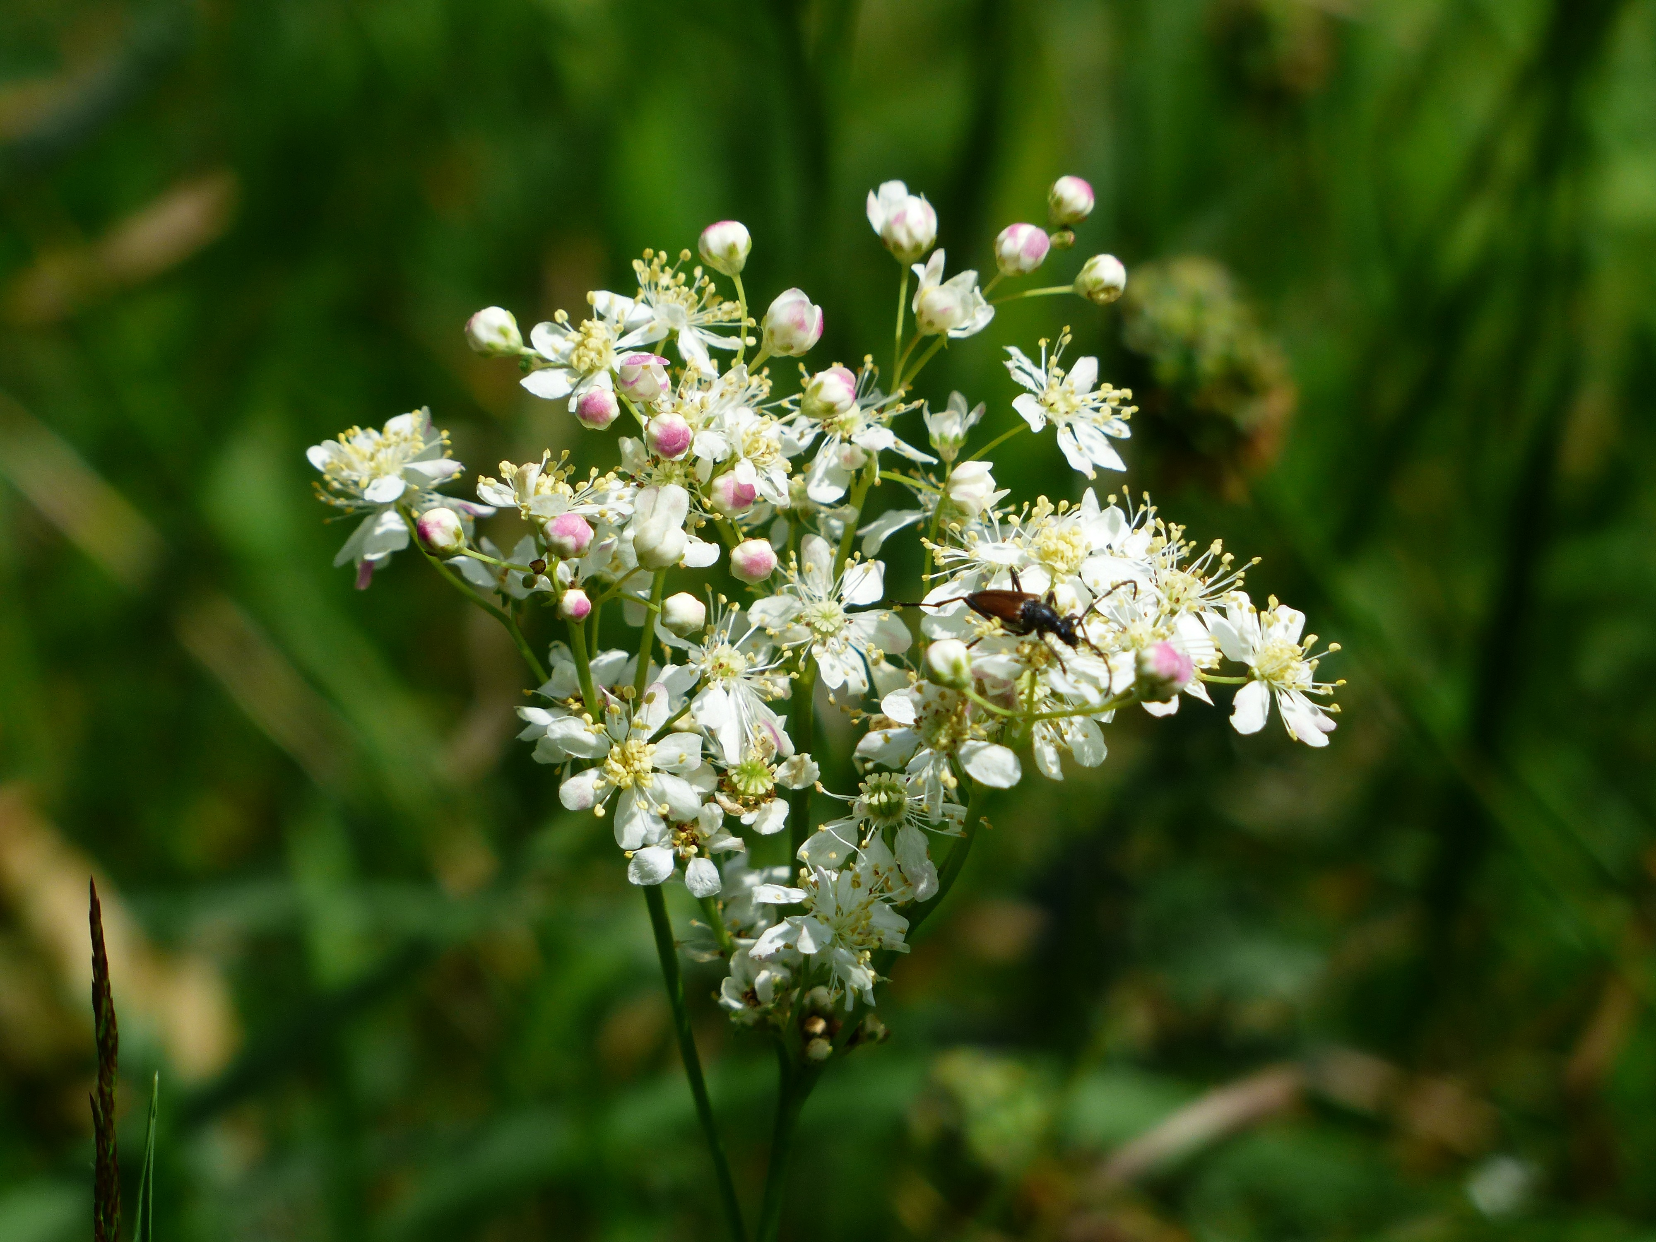

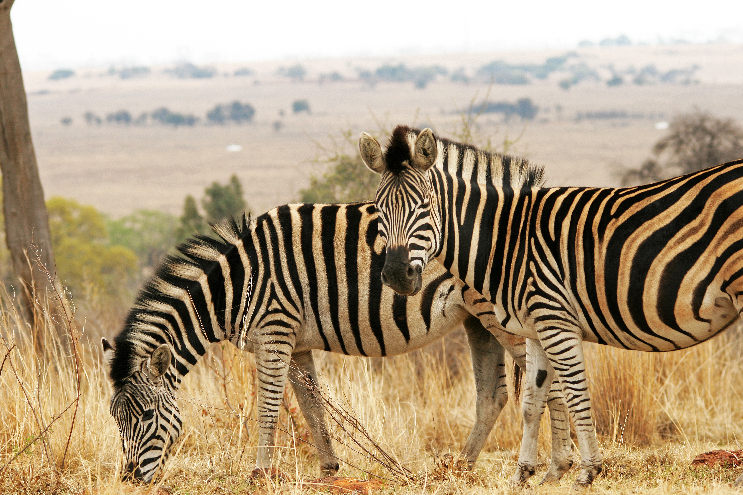
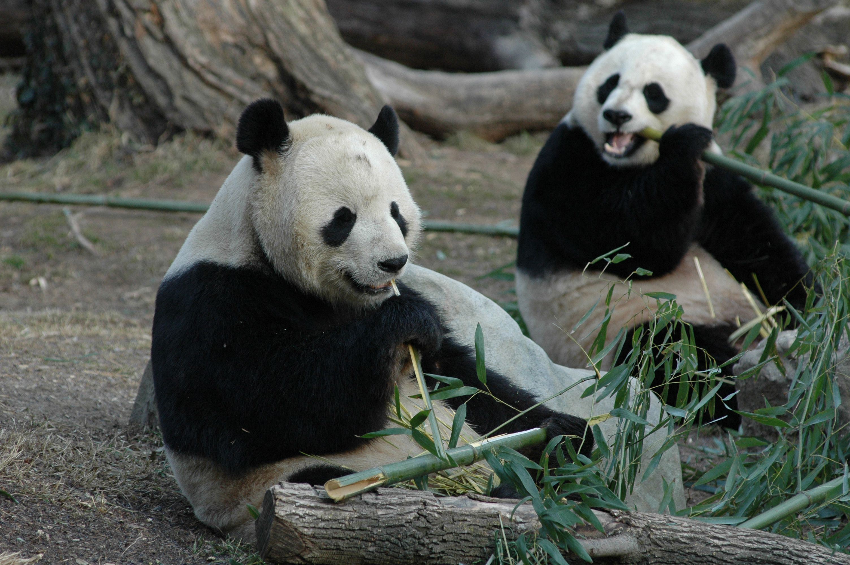


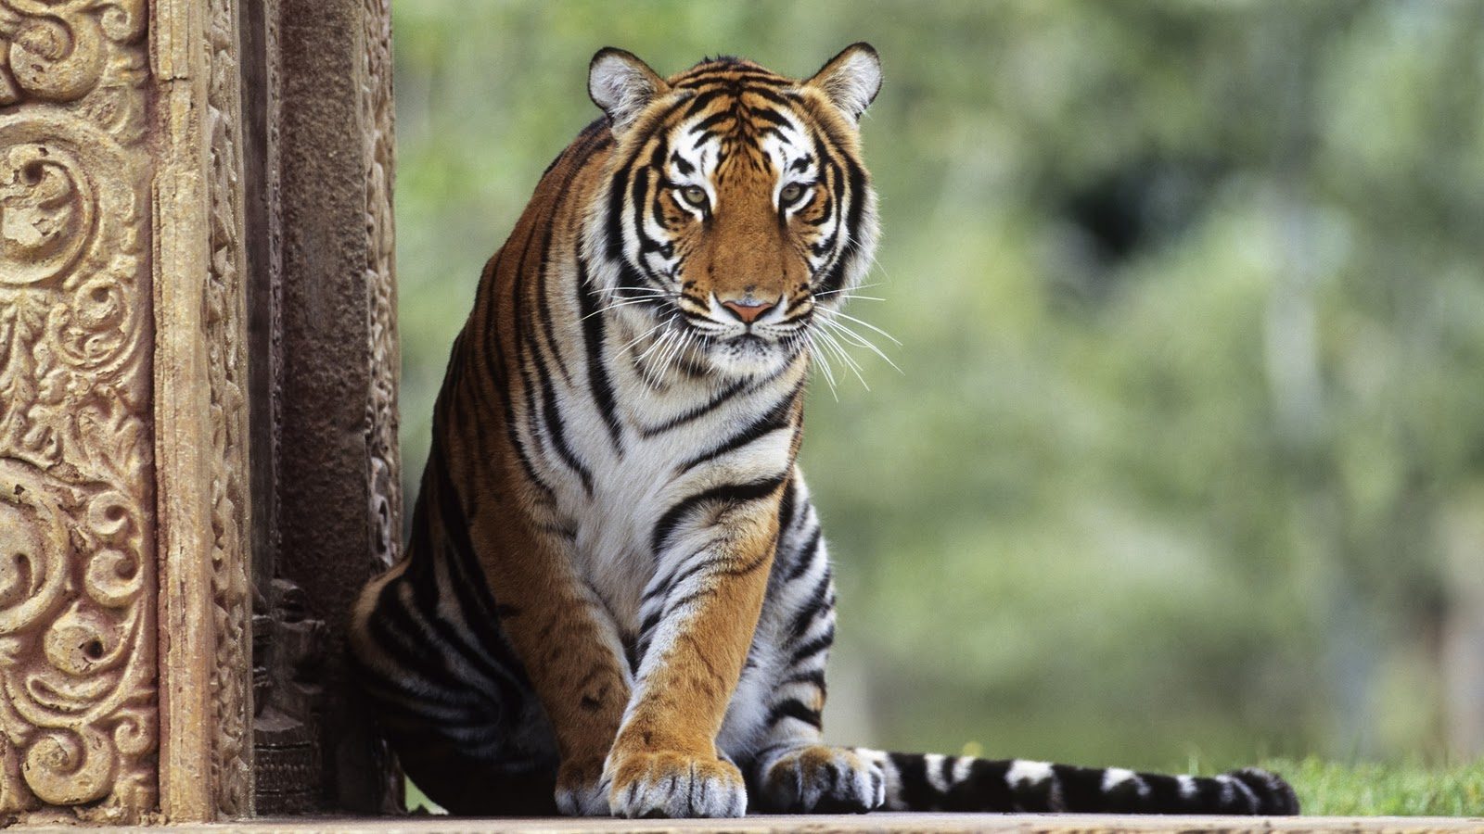
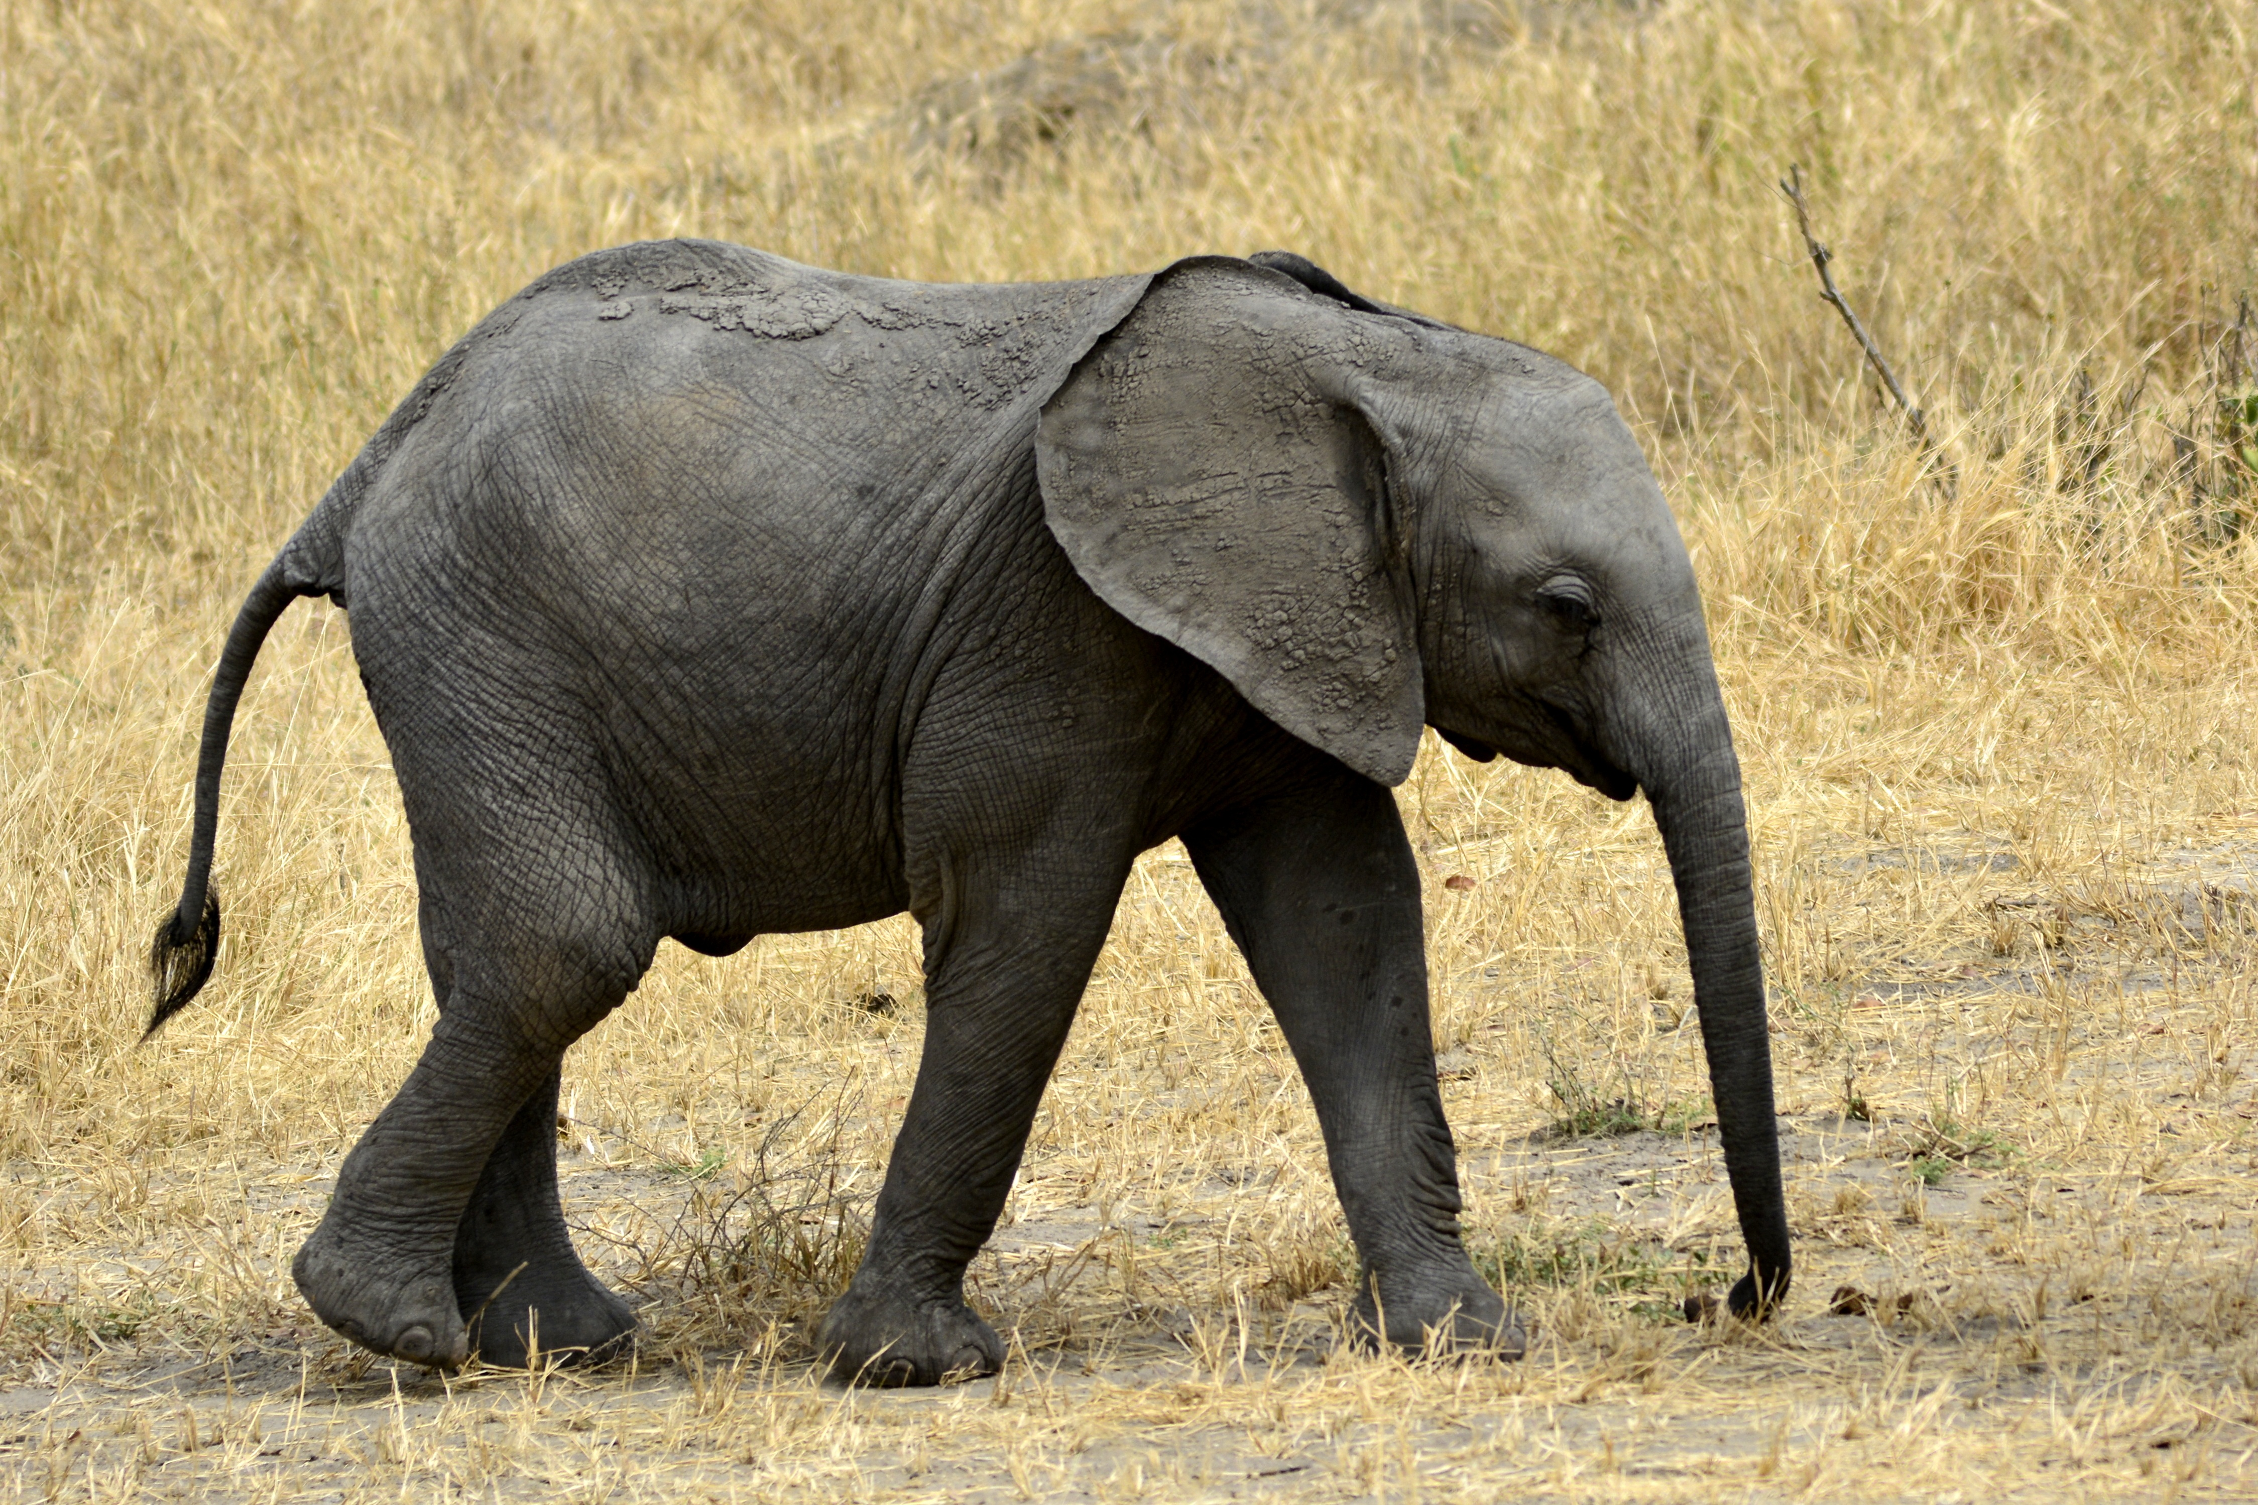
introduction
Wildlife
Flora
(All the naturally occurring plant life present in a particular region.)
fauna
(All the animal life present in a particular region.)

Slide 4
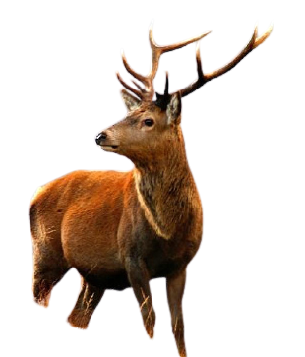

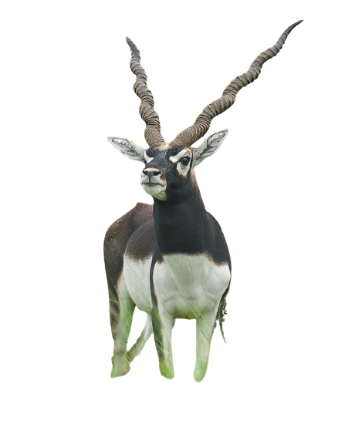

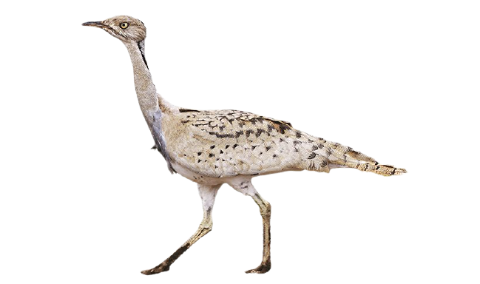
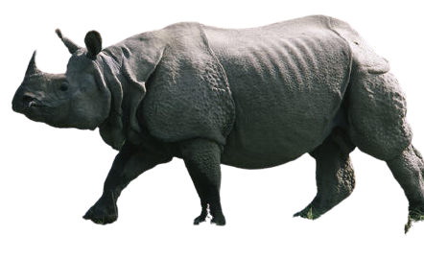
Categories
Extinct | Endangered | Vulnerable | Least Concern
The Indian Auroch Malabar Civet Pink headed Duck Himalayan Quail | The Great Indian Bustard Bengal Tiger Kashmiri Red Stag Ganges Dolphin Asiatic Lion One Horned Rhinoceros | Blackbuck Barasingha Yak Olive Ridley Turtle | Giraffe American alligator Golden eagle Red fox Plains zebra

Slide 5
Threats to Indian wildlife
FAUNA
FLORA
Invasive species (Eg. Water Hyacinth, Black mimosa)
Climate change
Habitat Loss
Invasive species (Eg. Black Wattle, Indian Bullfrog)
Climate change
Poaching
Habitat Destruction
Fragmentation and degradation
Pollution
Poor waste disposal and pollution

Slide 6
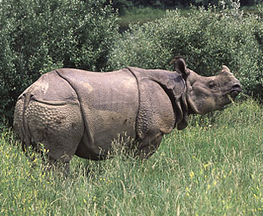
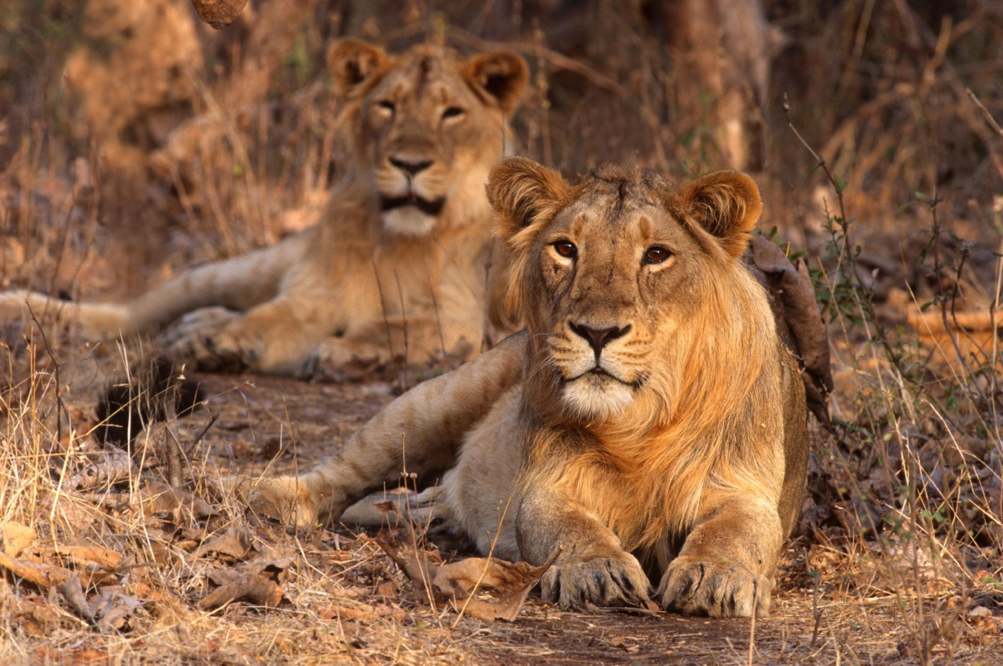
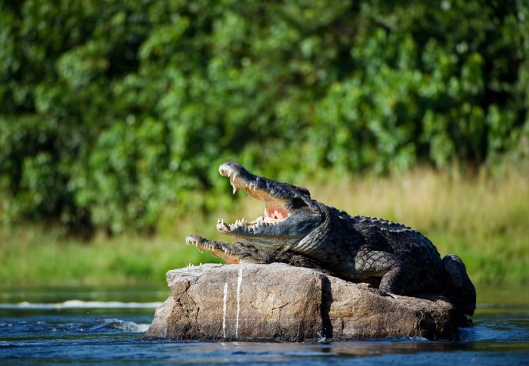
Endangered species
Interesting
FACTS
CURRENT NUMBERs OF
ENDANGERED SPECIES
Species | number
One- Horned Rhinoceros | 3,500
Asiatic Lion | 674
Ganges Dolphin | 41
The Great Indian Bustard | 110
The Indian rhinoceros, also called greater one-horned rhinoceros is a rhinoceros species native to the Indian subcontinent.
The Lion is found naturally only in India, besides Africa. In India, its only one natural habitat is Gir forest (Saurashtra) in Gujarat.
Project Crocodile was launched in 1975. Programmes are being run at several places for encouragement of its protection and safe reproduction.

Slide 7

EXISTING LAWS
1972
Wildlife Protection Act
1986
The Environment Protection Act
According to India’s Wildlife Protection Act 1972, accepting any protected wildlife or wildlife part either wild animal or any specified plant or tree without permission, is punishable under law and can lead to imprisonment of up to 6 years and/or a fine.
2002
2017-2031
The Biological Diversity Act
National Wildlife Action Plan

Slide 8




Steps Taken by Indian government
Eco-developmental projects
assistance
Protected areas
Legal protection
Project Tiger, Project Elephant, Project Great Indian Bustard
Financial and technical assistance is provided to many botanical gardens
provided to wild animals against hunting and commercial exploitation
18 biosphere reserves, 103 National Parks, 535 Wildlife sanctuaries and Zoological gardens are set up to take care of natural heritage.

Slide 9

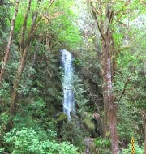


World-wide VIEW On WILDLIFE
International Union for Conservation of Nature(IUCN)
Red List of Threatened Species
Uses a set of precise criteria to evaluate the extinction risk of thousands of species.
World Wildlife Day is celebrated on 3rd March every year.
The World Wide Fund for Nature (WWF)
An international NGO founded in 1961
Works in the field of wilderness preservation
Work for the reduction of human impact on the environment.
The United Nations Environment Programme (UNEP)
Hosts the Convention on International Trade in Endangered Species of Wildlife Fauna and Flora.

Slide 10


Proposed solutions
The WAKE-UP Bill
W -
A -
K -
E -
U -
P -
Wildlife
Awareness &
Kindness towards
Endangered and
Under Threat Species
Protection

Slide 11
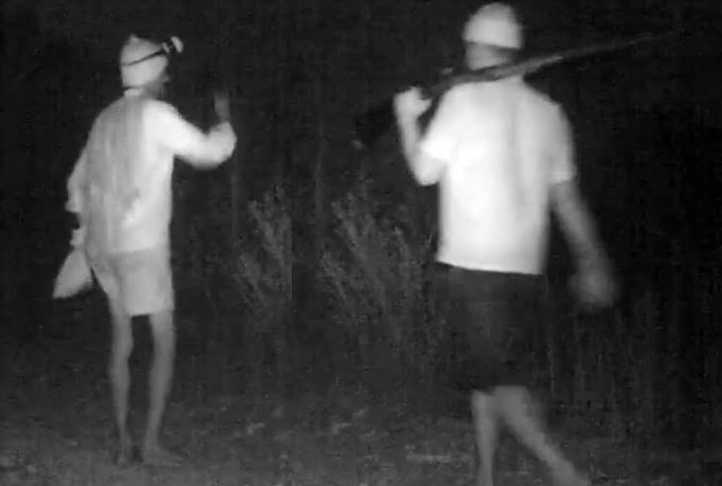


1. use of technology
Poachers’ photograph captured by AI technology
Conducting scientific research, synthesizing data and using that information to prioritize conservation efforts.
Develop an AI system capable of providing 24/7 monitoring for any given conservation area or wildlife reserve in the country.

Slide 12
2.
Ecosystem restoration
Preserve habitat.
Restoration of degraded habitats outside protected areas.
Try and restore extinct species by recreating their natural habitat.
Afforestation
THE 3 R’s
Restrict livestock from riparian areas.
Remove toxic materials from soil and sediments.
Root out invasive exotic species.

Slide 13

3.
Wildlife crime prevention
Increasing the funding to tackle and prosecute illegal poachers
Penalties on those who do not obey the wildlife law.
Empowering the people: Supporting social campaigns which involve common people, can be a step towards saving the endangered life forms.

Slide 14
education and awareness
4.
Inclusion of wildlife related insights in students’ syllabus in school textbooks
Make people aware of the existing wildlife laws
Appoint Government officials to survey and collect information on wildlife even in non-protected areas.
They must keep updating about the situation to the surrounding residents

Slide 15
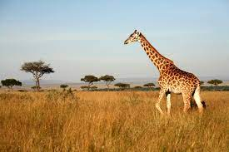
CONCLUSION
“Wildlife is something which a man cannot construct.
Once it is gone, it is gone forever.
Man can rebuild a pyramid but he cannot rebuild ecology.”
-Joy Adamson
Let’s WAKEUP to preserve and protect wildlife!

Slide 16
THANK YOU!

